Slide 1
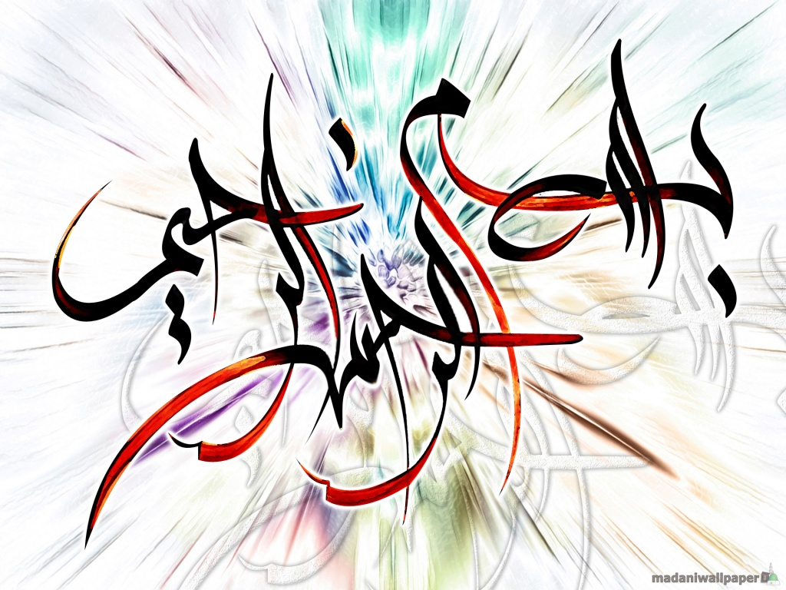

Slide 2
Child Labour In Pakistan

Slide 3
Description
Today Pakistan is facing a lot of social problems but some are very common in Pakistan, which are destroying our society and also economy of Pakistan.
Like CORRUPTION, Poverty, Illiteracy, Population Growth, Terrorism, Smuggling, Drug abuse, etc etc etc…

Slide 4
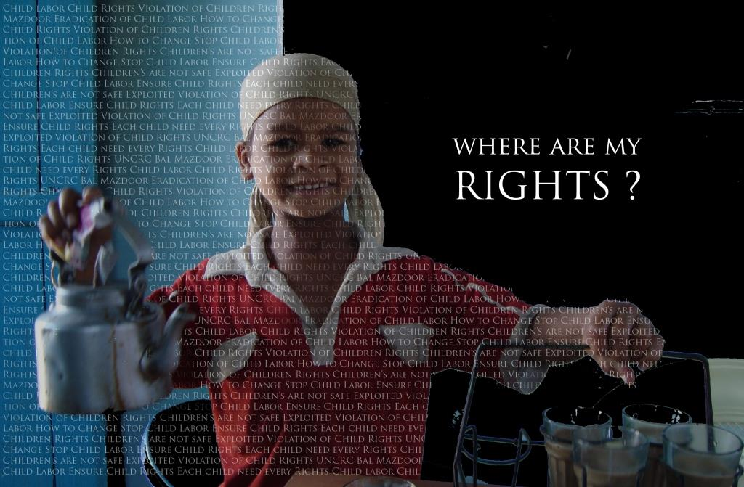
Forget corruption there are bigger issues other than corruption which needs our attention.
Child labour is one of such issue. We don’t come across corruption cases every day but we see a CHHOTU everyday with tea glasses in his hand and a question in his eyes. Have we answered that question????????.............

Slide 5
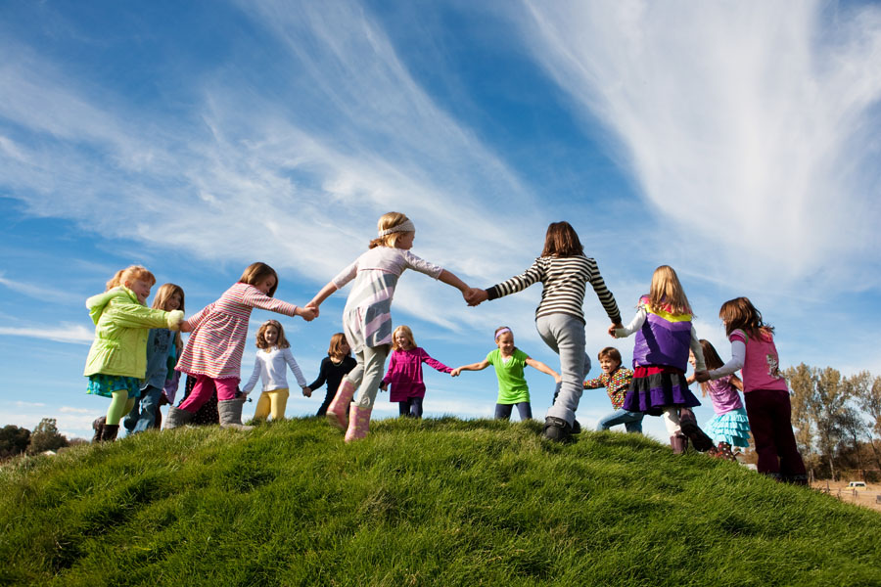
THIS IS WHAT WE CALL LIFE..

Slide 6
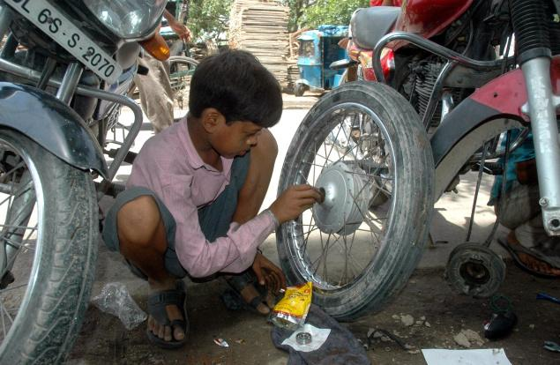
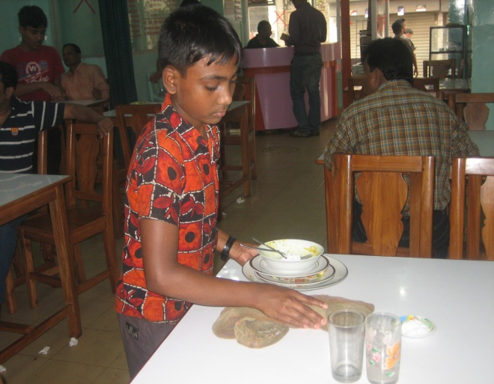
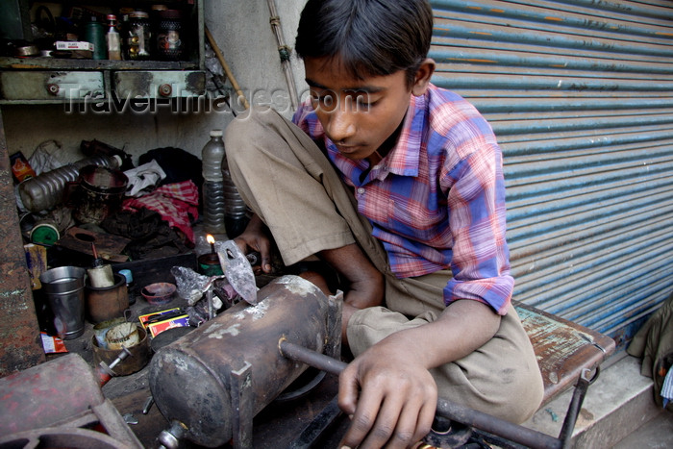
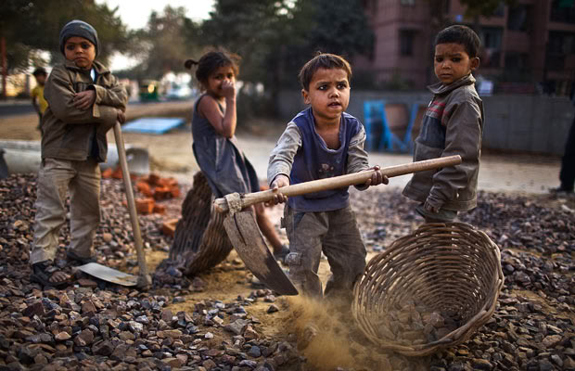
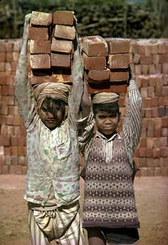
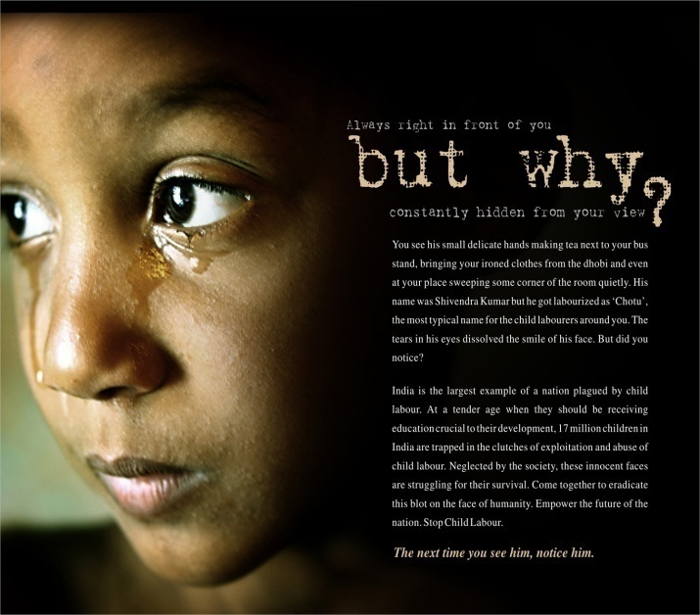
But.. This is also Life..

Slide 7

Child LABOUR in Pakistan.
The topic which We have selected is
(A SOCIALLY ACCEPTED CRIME)

Slide 8
Introduction
Child labour has become a major issue throughout the world but in the third world countries, like Pakistan, it has grown to the maximum level.
This international problem is becoming intense with every passing day because a large number of children are forced to do work which is completely against the law.
According to United Nations International Children Emergency Funds (UNICEF) there are approximately 158 million children of age 5 to 15 working as child LABOUR worldwide.

Slide 9
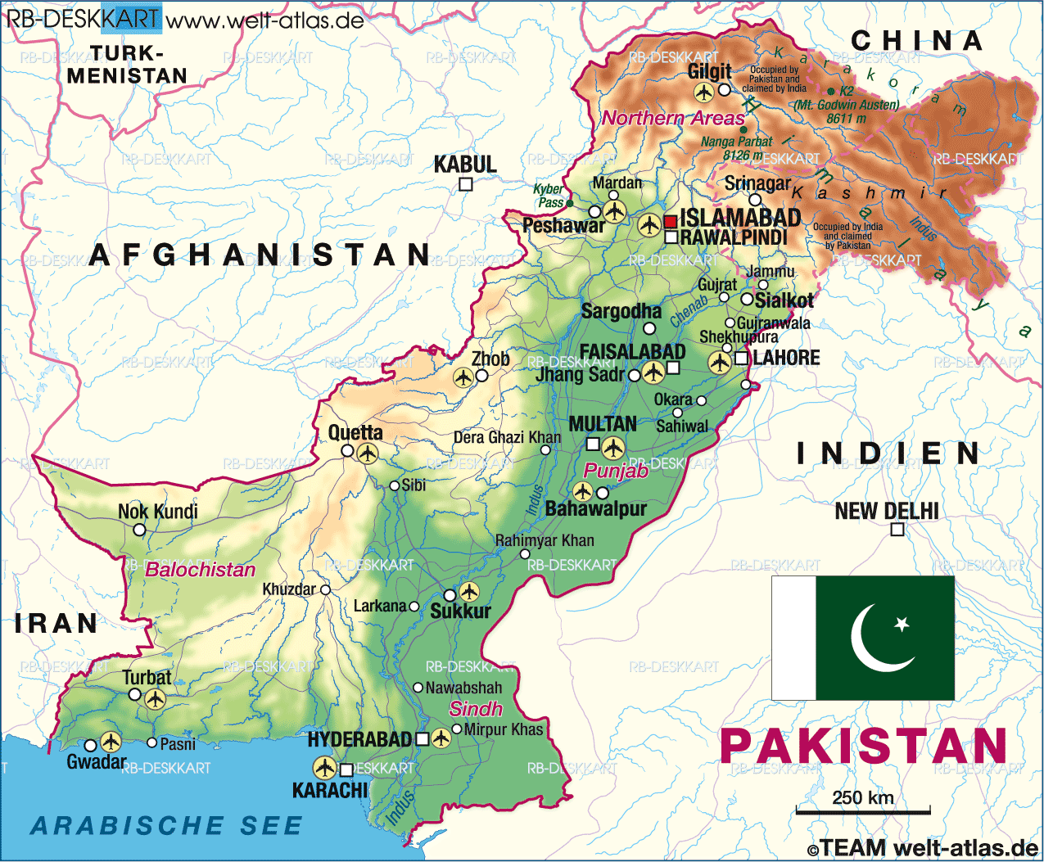
CHILD LABOUR IN PAKISTAN
Child labour is a socioeconomic problem of Pakistan from the beginning and presenting negative effects till now.
Today child LABOUR in Pakistan is the most prominent issue of all the social issues.

Slide 10
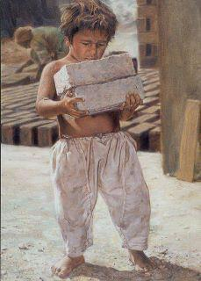
What is Child Labour?
The term “child labour” is often defined as:
“work that deprives children of their childhood, their potential and their dignity, and that is harmful to physical and mental development.”

Slide 11

UNICEF Defines:
United Nations International Children’s Emergency Fund(UNICEF) defines:
“child” as anyone below the age of 18, and “child Labour” as some type of work performed by children below age 18. (UNICEF)

Slide 12
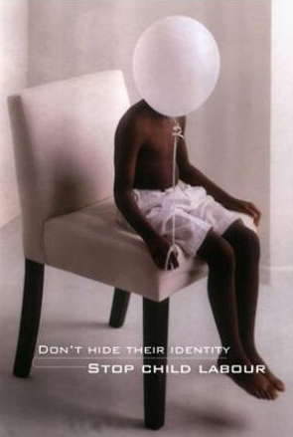
The Question Arises…!
How and why do children in Pakistan get into child LABOUR (Causes)?
What are the different types of child LABOUR found in Pakistan?
How are the children affected?
What’s being done in Pakistan and other countries to stop child LABOUR?

Slide 13

CAUSES
OF
CHILD
LABOUR

Slide 14
The Different Ways and Reasons Pakistani Children Get into Child LABOUR
Reasons
Poverty
Uneducated
Business Advantage
Ways
Peshgi system
Family Expectations or Needs

Slide 15
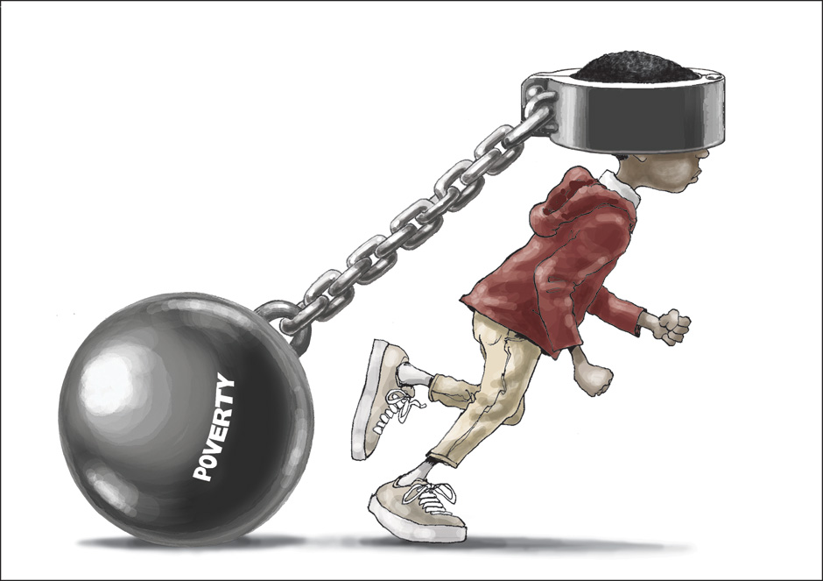
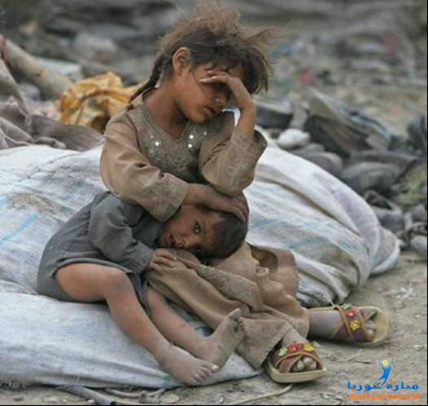
Poverty
Poverty is the basic reason and driving force that compels these children to work like labours and earn a little money at the end of the day. The bad financial condition up-thrust to the problem of child labour.

Slide 16
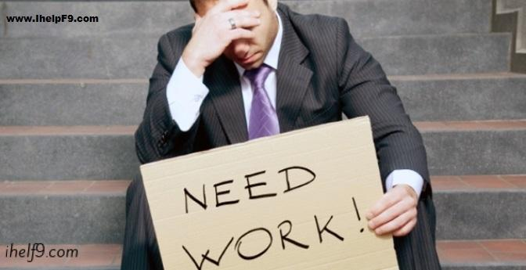
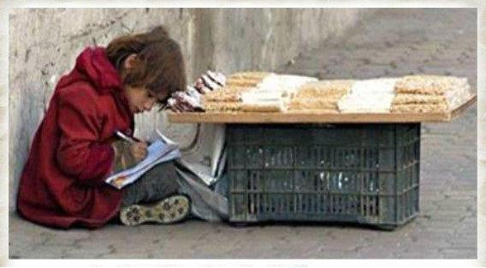
Unemployment Of Elders.
Another important reason is unemployment which forces the parents to send
their children to work places
Due to unemployment its become compulsion of parents to make their children
to work in factories, shops, even selling items on streets.
There are many cases of child LABOUR where a child has to work against the
repayment of a loan which was taken by his father.

Slide 17

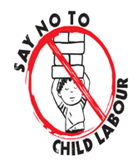
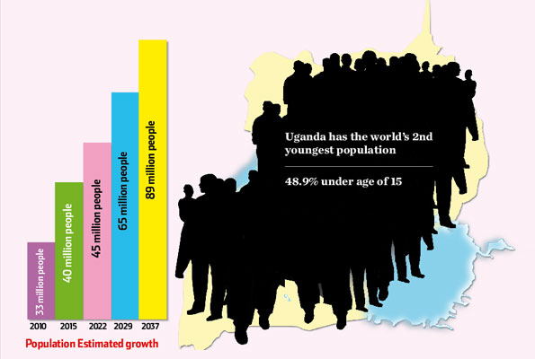
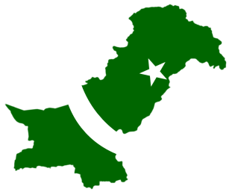
Excess Population
In villages there is trend of early marriages and have large number of children. To fulfill the basic needs they compel their children to do work.
So they have no other choice but to work and earn a little amount to support their families
They consider children as their source of income and they make them to work like pulling carts, repairing machines, work in factories, selling goods etc.

Slide 18
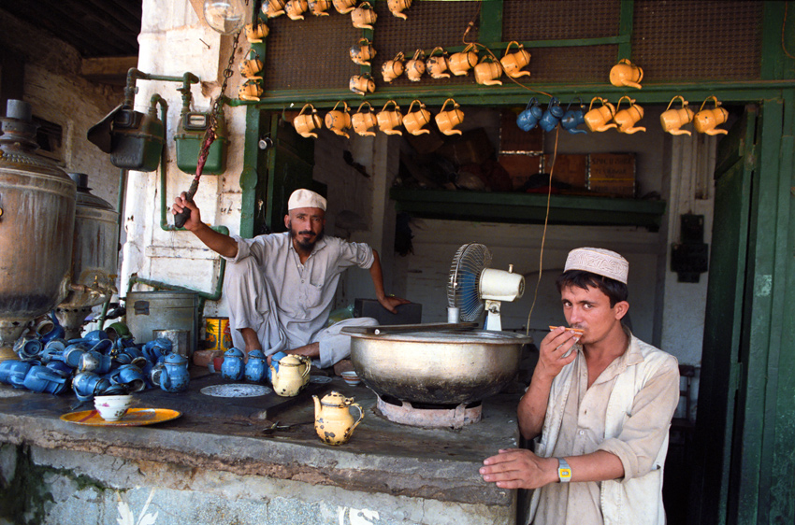
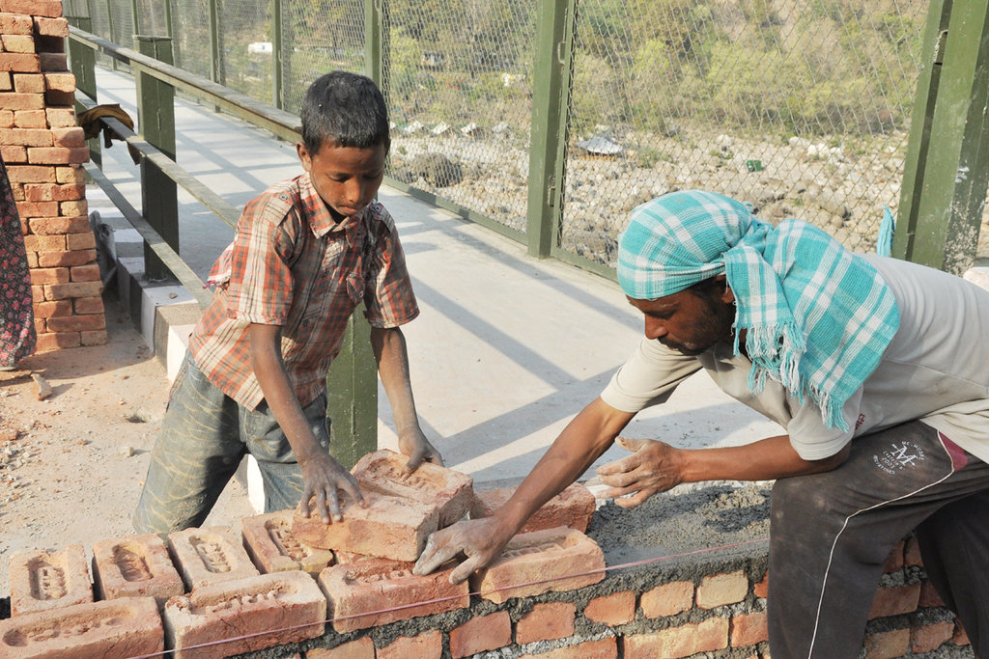
Tradition Of Making Children Learn The Family Skills
Children are force to follow the foot prints of their parents.
They are trained from their childhood in the profession that the family has been following since ages. So they are unable to get primary education .
Children are forbidden from doing any
other work. Because of this the
children of labourers, craftsmen etc.
start working with their parents at a
very young age.

Slide 19
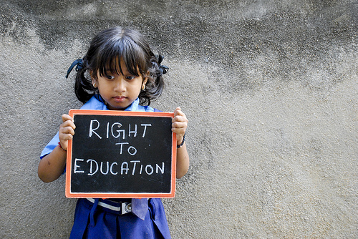
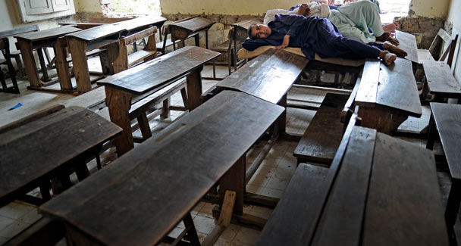
Parental illiteracy
Many developing countries like Pakistan, India, Bangladesh etc. facing a huge problem of illiteracy. Lower class people are mostly illiterate, so it is difficult for uneducated parents to understand the importance of education for their children.
Literacy rate of Pakistan is :
Male: 68.6%
Female: 40.3%
Pakistan has allocated only 2.3 % of the budget for education, which is 0.3% than in 1999

Slide 20
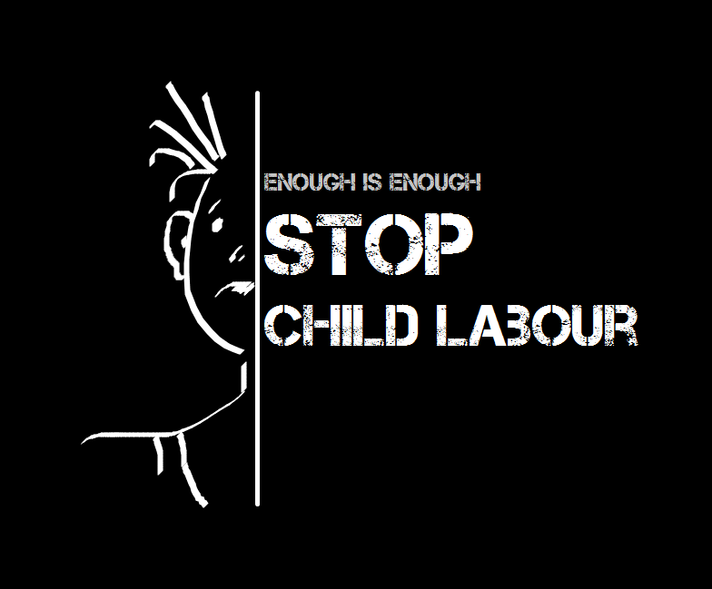
Failure Of Laws
Another main reason for the promotion of child labour is due to the failure of government in practicing the laws to stop child labour due to which child labour is increasing day by day .

Slide 21

A Fact..
Pakistan is amongst the top ten countries having the issue of child labour
According to HRCP , Children between 5-15 in Pakistan are above 12 million..
50% of these economically active children are in age group of 5 to 9 years.
According to HRCP majority children are working in the agriculture sector.
73% of them are boys and the rest are girls

Slide 22
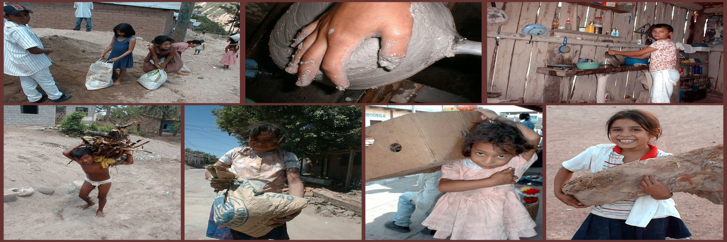
The Different Types of Child LABOUR:
Agriculture
Carpet Weaving
Soccer Balls
Automobile Workshops
Mining
Stone/ marble cutting
Mixing Pesticides
Deep fishing
Glass factory
Hotel / Textile factory Work
Street work
And much more

Slide 23
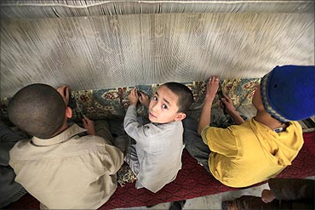
Carpet Weaving
Most popular export from Pakistan
Somewhere between 500,000- 1 million Pakistani children work as full- time carpet weavers

Slide 24
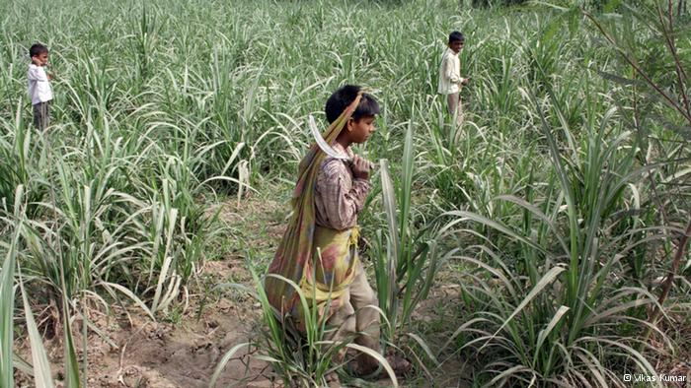
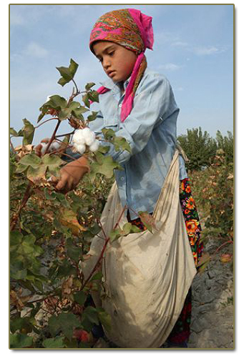
Agricultural Work
Nearly 70% of child LABOURers, work in
agriculture, fishing, forestry and hunting.
Child agricultural workers frequently work for long hours in scorching heat, haul heavy loads of produce, are exposed to toxic pesticides

Slide 25
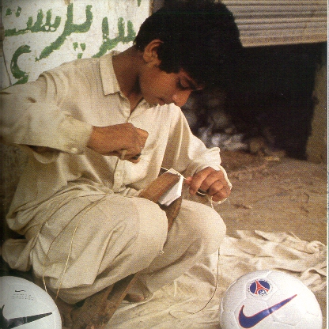
Soccer Balls
Majority of world’s soccer balls are made in Pakistan
35 million Soccer Balls are made in Pakistan, and children make a quarter of them

Slide 26
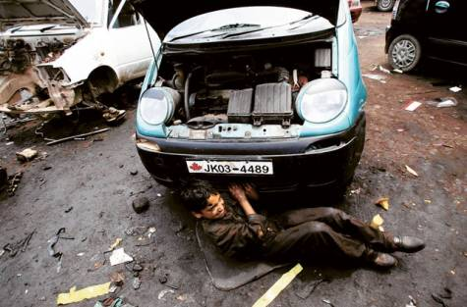
Automobile Workshops
In one automobile workshop of 150 working children, 120 of them worked from 8-10 hours without any safety measures

Slide 27
EFFECTS
OF
CHILD
LABOUR

Slide 28
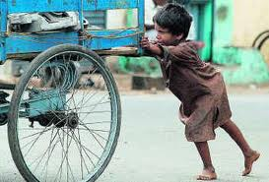
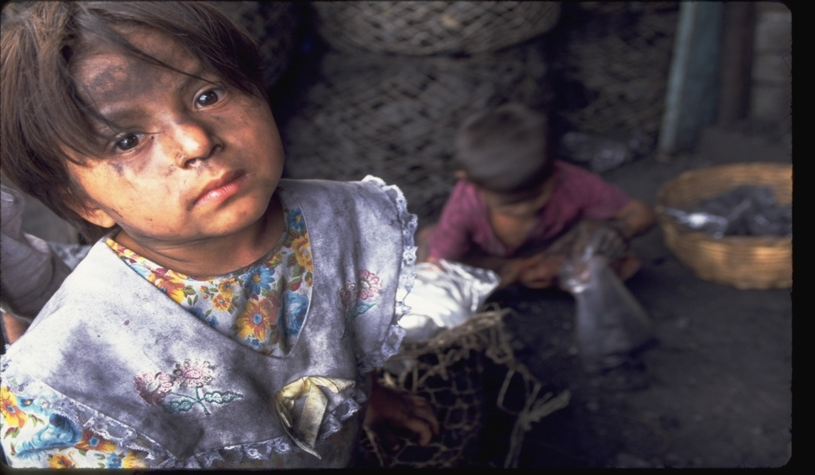
EFFECTS OF CHILD LABOUR
There are many bad effects of child LABOUR on our society some of
them are as follow:
Child labour forces some children to steal things from others in order
to satisfy their daily living.
Child LABOUR deprives a child from the basic right of education.

Slide 29
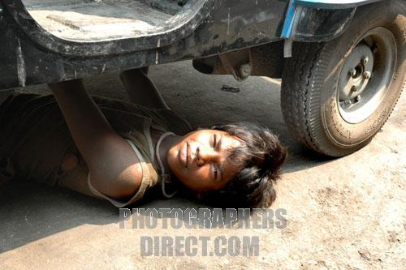
Mental Effects
In one engine repair factory the lead levels were so above the safety limits, that red cells were mutated. This has a huge effect on a child’s mental development.

Slide 30
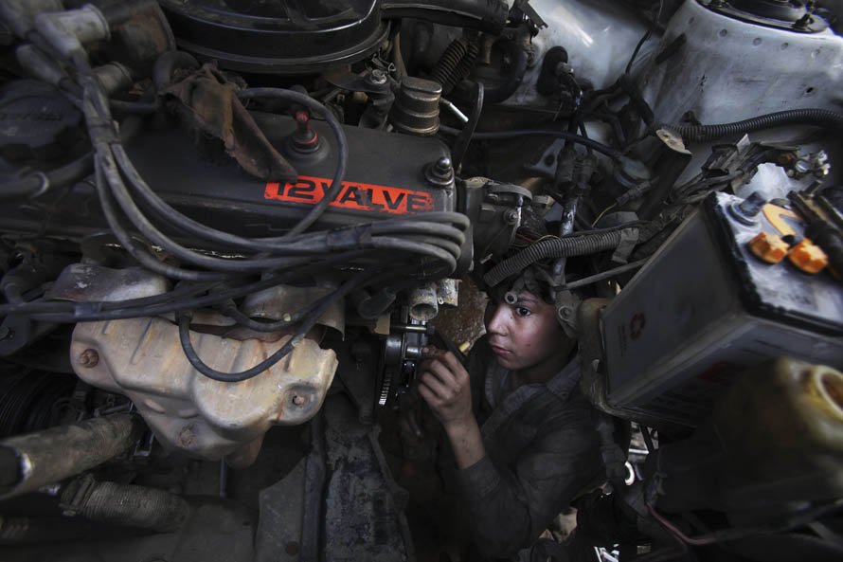
Physical Effects
In the automobile industry it’s an unsafe, polluted environments
Some chemicals have messed up their growth
In manufacturing units children suffered from nasal irritations, sore throats and skin rashes

Slide 31
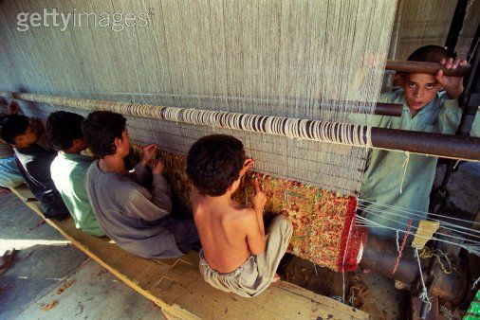
Carpet Weaving Physical Affects
Muscular deformities and respiratory infections from the fibers and chemicals.
Injuries from to sharp instruments and body aches
They strain their eyes and the children also develop spinal deformities.

Slide 32
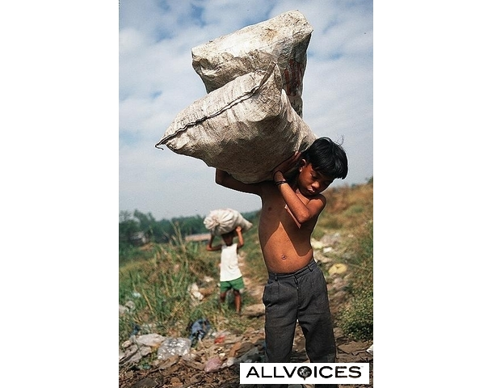
Agriculture Physical Affects
High rates of injuries while working with sharp tools, and other heavy equipment.
An estimated 100,000 children suffer from agriculture-related injuries in Pakistan annually

Slide 33
SOLUTION
&
SUGGESTIONS..

Slide 34
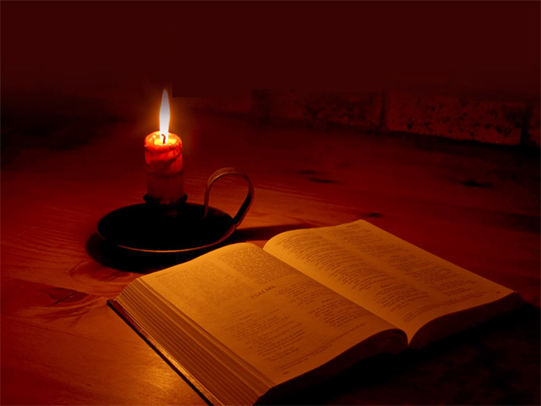
SUGGESTIONS
Awareness must be raised and parents should pay attention to the education of their children.
Child LABOUR Laws should be strictly put into practice, and then our country can easily get rid of this problem.
we should to distribute the education free of cost, give flame to the candle of education and distribute the light of knowledge among the people

Slide 35
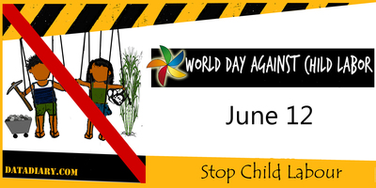
WORLD DAY AGAINST CHILD LABOUR
On 12 June, people around the world join hands to mark the World Day Against Child Labour – to raise awareness and contribute to ending child labour .

Slide 36

Pakistan’s Efforts
The Employee Children Act, 1991
Punjab Compulsory Education Act 1994
The government gave free books to primary schools so parents with limited budgets are now able to send their children to schools

Slide 37
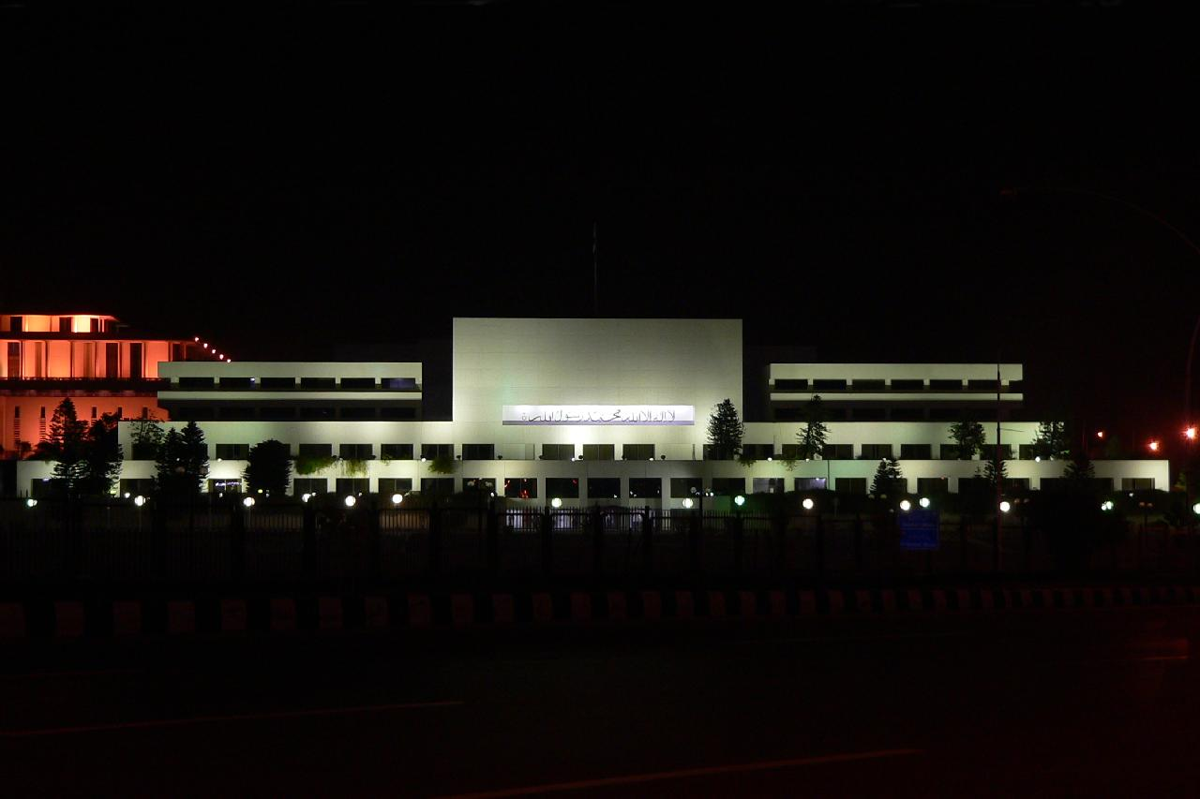
NO laws are enforced
The Pakistan Parliament is a part of the elite, so they pay no taxes and don’t want to make any changes to the system

Slide 38
Conclusion:
Child labours are working not the choice of their own. They are the victims of their circumstances and we are taking benefit of their compulsions.
These children are working as a LABOUR in school going age for the survival of their families and to full fill the basic necessities.
Government should provide the basic rights to these children and should also help them in getting education in this way our country can get rid of social evil.

Slide 39
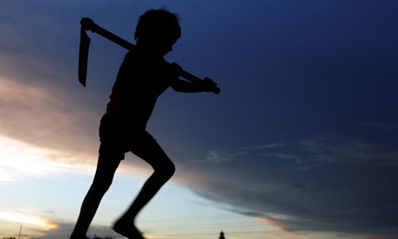
THANK
YOU

